Slide 1
CSE 12 – Basic Data Structures and Object-Oriented Design Lecture 10
Paul Cao and Greg Miranda, Winter 2021
This lecture is being recorded

Slide 2

Announcements
Quiz 10 due Monday @ 8am
Survey 4 due Friday @ 11:59pm
PA3 due tonight @ 11:59pm
Exam 1 on Friday (no class)
Released @ 8am on Friday
Closes @ 10am on Saturday
More details on Piazza

Slide 3
Topics
Questions on Lecture 10?
Big O

Slide 4
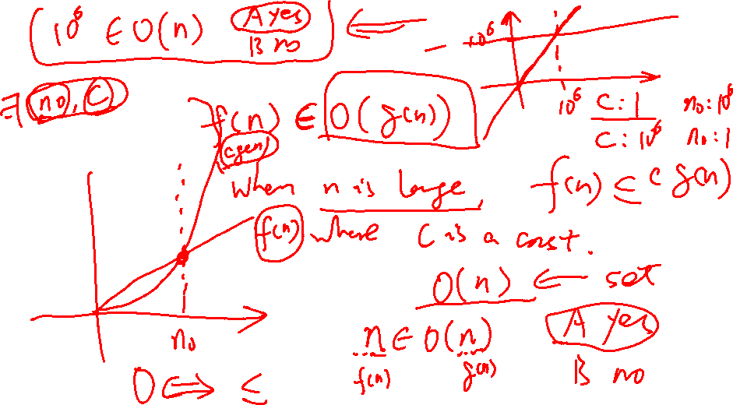
Questions on Lecture 10?

Slide 5
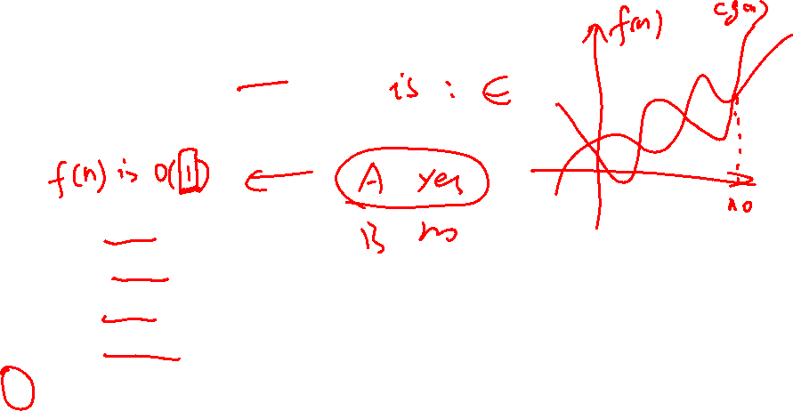
Let f(n) = 100
Which of the following is NOT a correct bound?
f(n) is O(2^{n})
f(n) is O(n²)
f(n) is O(n)
f(n) is O(n¹⁰⁰)
None of these

Slide 6
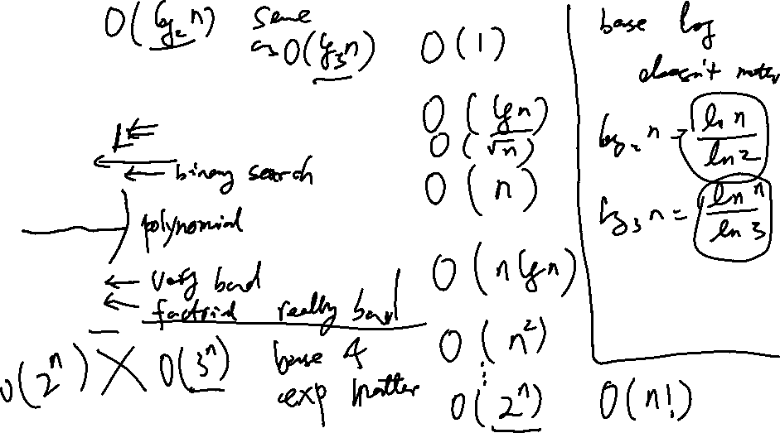
For each function in the list below, it is related to the function below it by O, and the reverse is not true. That is, n is O(n²) but n² is not O(n).
f(n) = 1/(n²)
f(n) = 1/n
f(n) = 1
f(n) = log(n)
f(n) = sqrt(n)
f(n) = n
f(n) = n²
f(n) = n³
f(n) = n⁴
… and so on for constant polynomials …
f(n) = 2^{n}
f(n) = n!
f(n) = n^{n}

Slide 7
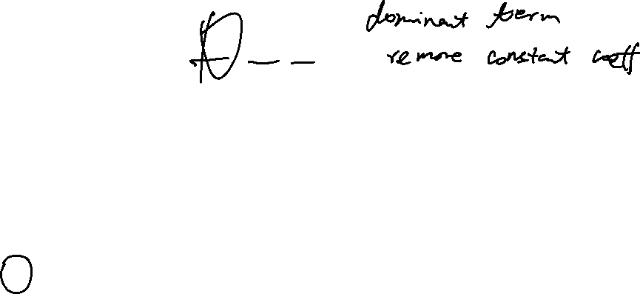
Let f(n) = 3n³ + 2n + 7
Which of the following is a correct bound?
f(n) is O(log(n))
f(n) is O(n²)
f(n) is O(n)
f(n) is O(n³)
None of these

Slide 8
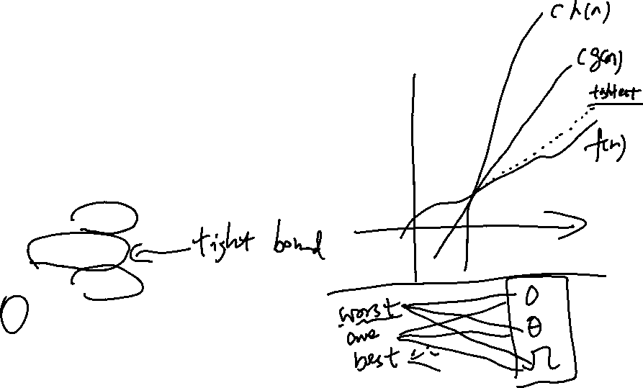
void printAllElementOfArray(int[] arr) { for (int i = 0; i < arr.legnth; i++) { printf("%d\n", arr[i]); } }
Which of the following is a correct bound?
f(n) is O(log(n))
f(n) is O(n²)
f(n) is O(n)
f(n) is O(n³)
More than one of these

Slide 9
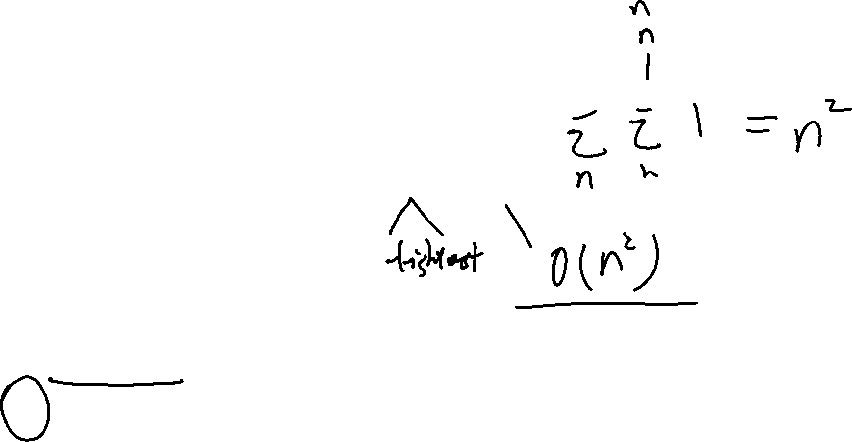
void printAllPossibleOrderedPairs(int arr[]) { for (int i = 0; i < arr.length; i++) { for (int j = 0; j < arr.length; j++) { printf("%d = %d\n", arr[i], arr[j]); } } }
Which of the following is a correct bound?
f(n) is O(log(n))
f(n) is O(n²)
f(n) is O(n)
f(n) is O(n³)
More than one of these

Slide 10
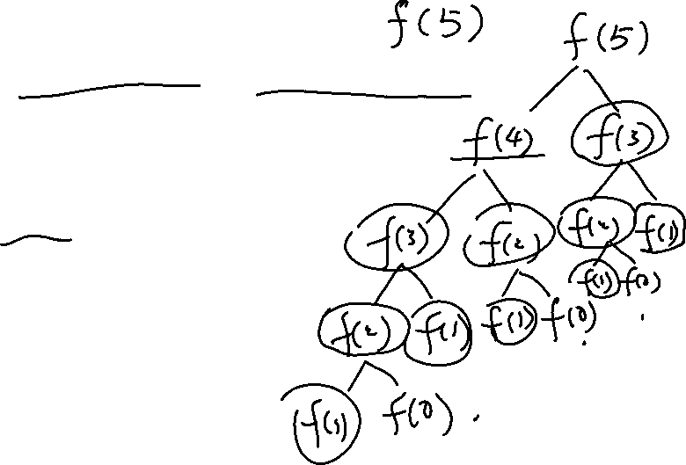
int fibonacci(int num) { if (num <= 1) return num; return fibonacci(num - 2) + fibonacci(num - 1); }
Which of the following is a correct bound?
f(n) is O(2^{n})
f(n) is O(n²)
f(n) is O(n)
f(n) is O(n³)
More than one of these

Slide 11
